Slide 1
Contextual Word Representations:
ELMo and BERT
From: https://web.stanford.edu/class/cs224n/slides/Jacob_Devlin_BERT.pdf
Slides are adopted from Advanced NLP course at UMass.

Slide 2


Contextual Embeddings
Word embeddings are the basis of deep learning for NLP
  Word2vec, GloVe, fastText
Problem:
  Always the same representation for each word, while it has multiple meanings depending on where it’s used.
Idea:
  Give each word an embedding based on the context it’s used in

Slide 3
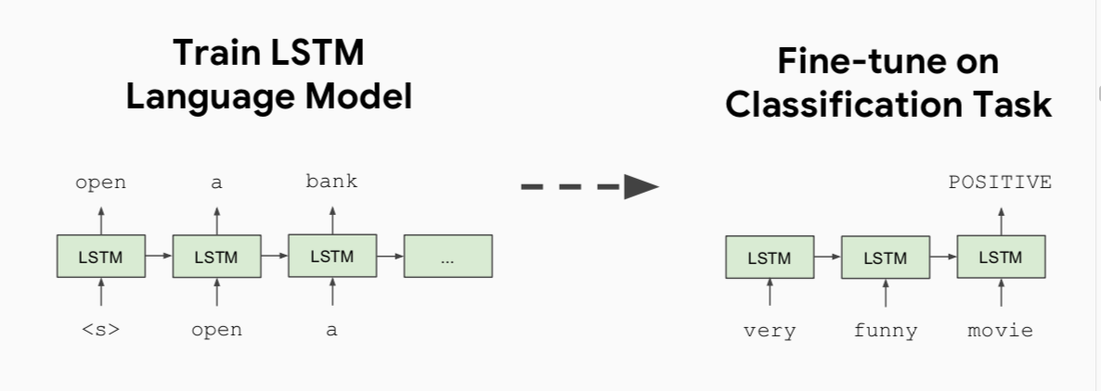
History of Contextual Representations
Semi-Supervised Sequence Learning, Google, 2015

Slide 4
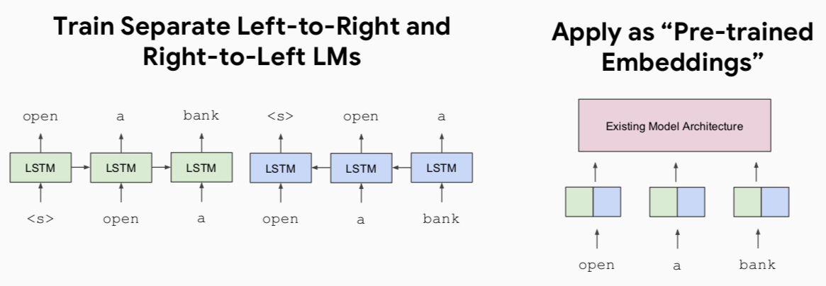
History of Contextual Representations
ELMo: Deep Contextual Word Embeddings, AI2 & University of Washington, 2017

Slide 5
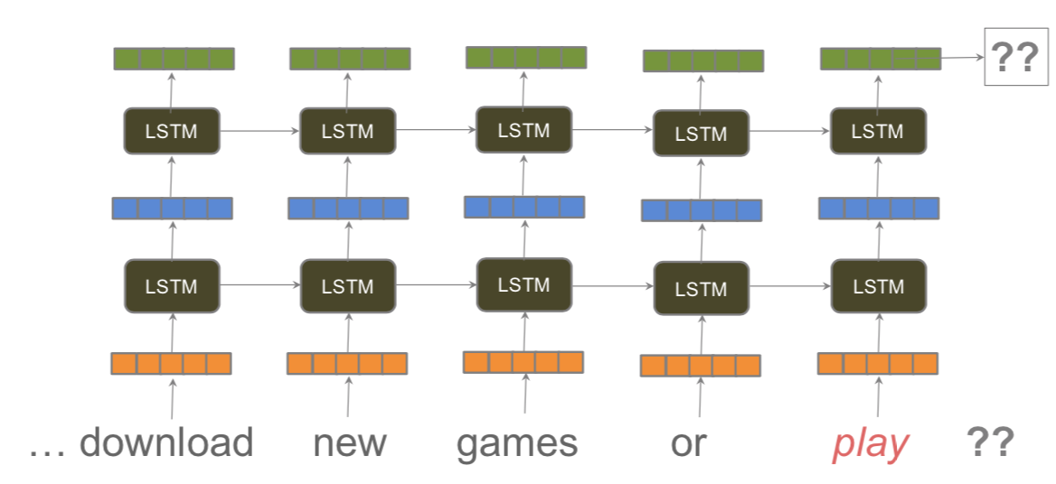
Deep language model

Slide 6
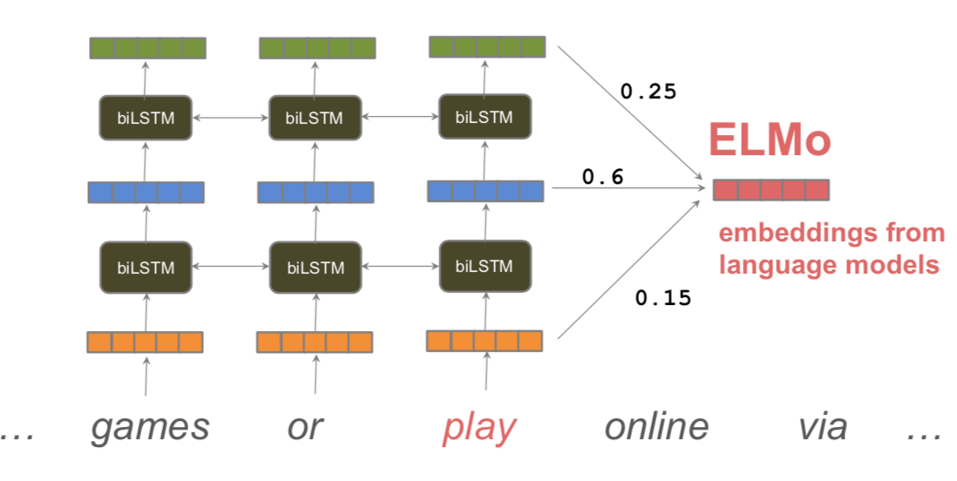
Use all layers of language model

Slide 7
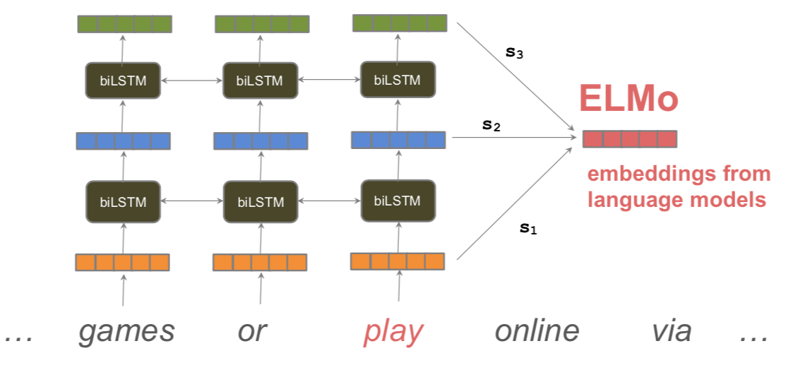
Learned task-specific combination of layer

Slide 8
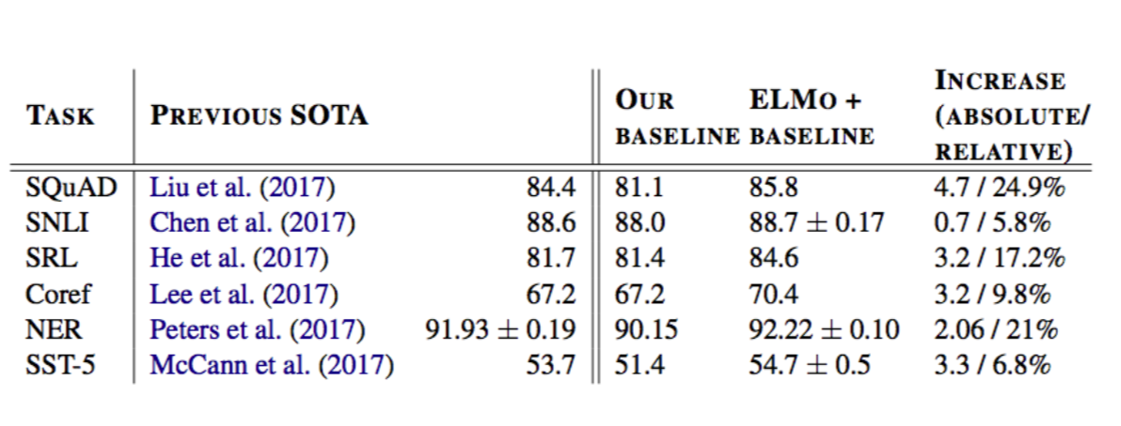
ELMo improves NLP tasks
Large-scale recurrent neural language models learn contextual representations that capture basic elements of semantics and syntax
E.g., the representations encode POS tags and word senses.

Slide 9
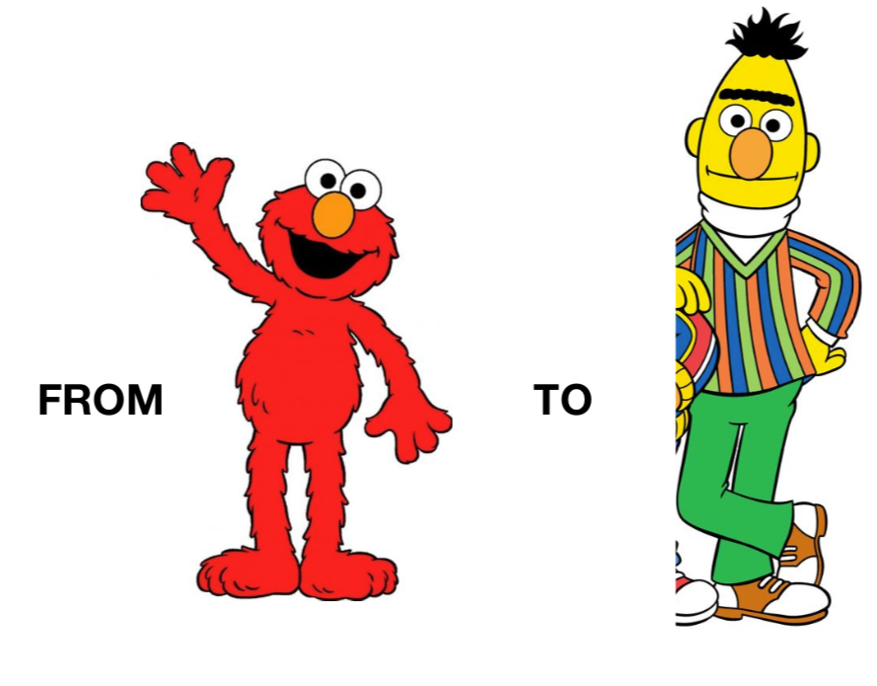

Slide 10
Problem with Previous Methods
Problem: Language models only use left context or right context, but language understanding is bidirectional.
Why are LMs unidirectional?
Reason 1: Directionality is needed to generate a well-formed probability distribution.
  We don’t care about this.
Reason 2: Words can “see themselves” in a bidirectional encoder.

Slide 11
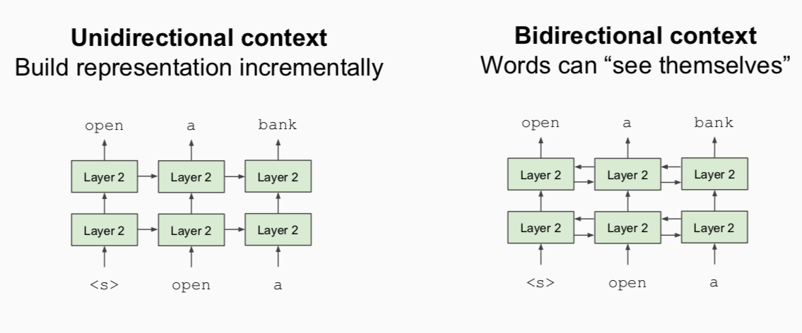
Unidirectional vs. Bidirectional Models

Slide 12
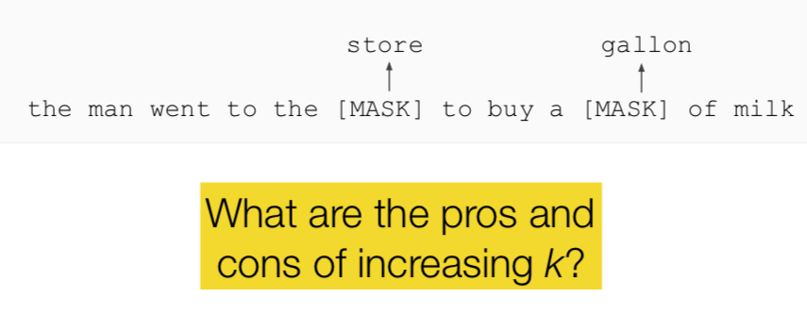
Masked LM
Solution: Mask out k% of the input words, and then predict the masked words
  k = 15% in BERT
Notes:
Too little masking:
Too expensive to train
Too much masking:
Not enough context

Slide 13
Masked LM
Problem: [Mask] token never seen at fine-tuning
Solution: 15% of the words to predict, but don’t replace with [MASK] 100% of the time. Instead:
80% of the time, replace with [MASK]
  went to the store → went to the [MASK]
10% of the time, replace random word
  went to the store → went to the running
10% of the time, keep same
  went to the store → went to the store

Slide 14
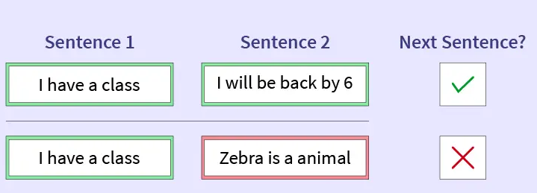
Next Sentence Prediction
To learn relationships between sentences, predict whether Sentence B is actual sentence that proceeds Sentence A, or a random sentence
https://www.scaler.com/topics/nlp/bert-next-sentence-prediction/

Slide 15
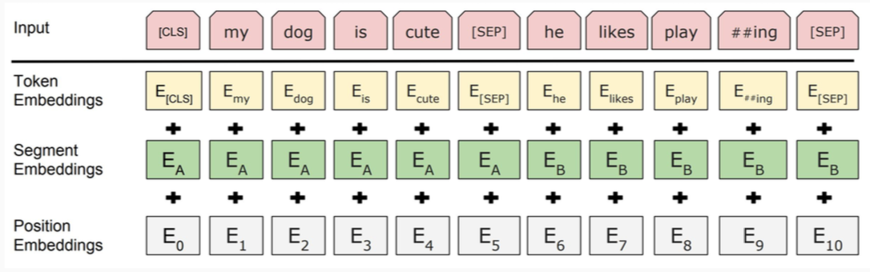
Use a 30,000 WordPiece vocabulary on input.
Each token is sum of three embeddings.
Single sequence is much more efficient.

Slide 16
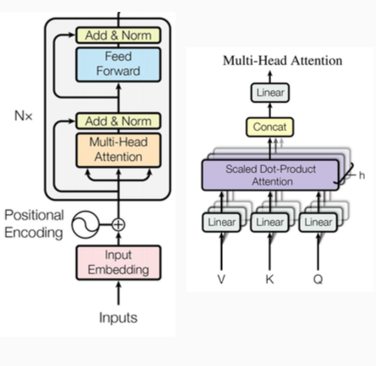
Model Architecture
Multi-headed self attention
  Models context
Feed-forward layers
  Computes non-linear hierarchical features
Layer norm and residuals
  Makes training deep networks healthy
Positional embeddings
  Allows model to learn relative positioning

Slide 17
Model Details
Data: Wikipedia (2.5B words) + BookCorpus (800M words)
Batch Size: 131,072 words (1024 sequences * 128 length or 256 sequences * 512 length)
Training Time: 1M steps (~40 epochs)
Optimizer: AdamW, 1e-4 learning rate, linear decay
BERT-Base: 12-layer, 768-hidden, 12-head
BERT-Large: 24-layer, 1024-hidden, 16-head
Trained on 4x4 or 8x8 TPU slice for 4 days

Slide 18
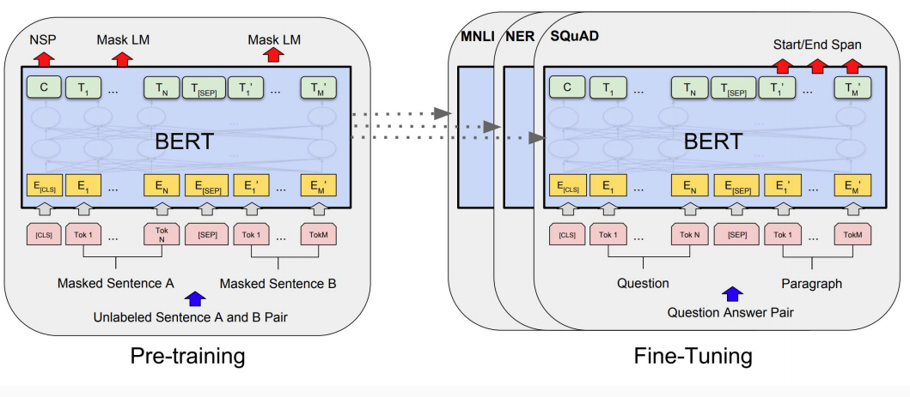
Fine-Tuning Procedure

Slide 19
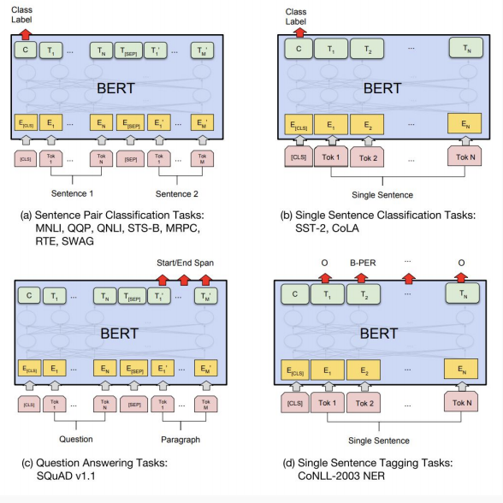
Fine-Tuning Procedure

Slide 20
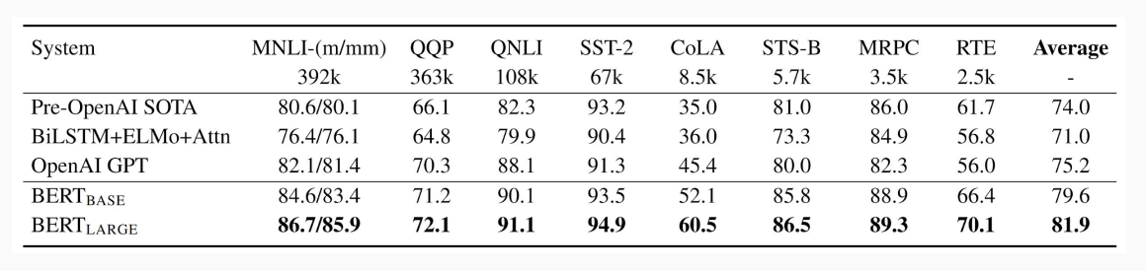
GLUE Results
GLUE is a set of NLU tasks designed to benchmark NLP models.

Slide 21
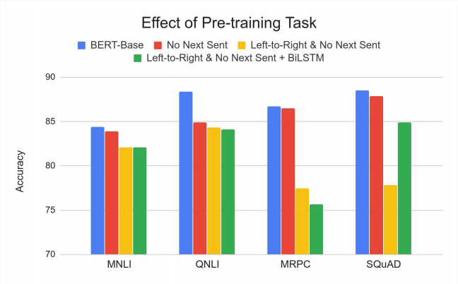
Effect of Pre-training Task
Masked LM (compared to left-to-right LM) is very important on some tasks, Next Sentence Prediction is important on other tasks.
Left-to-right model does very poorly on word-level task (SQuAD), although this is mitigated by BiLSTM.

Slide 22
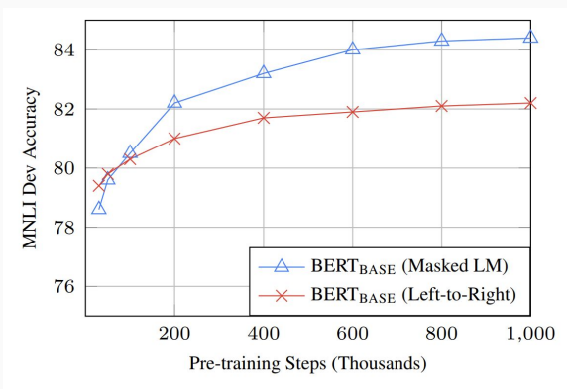
Effect of Directionality and Training Time
Masked LM takes slightly longer to converge because we only predict 15% instead of 100%
But absolute results are much better almost immediately

Slide 23
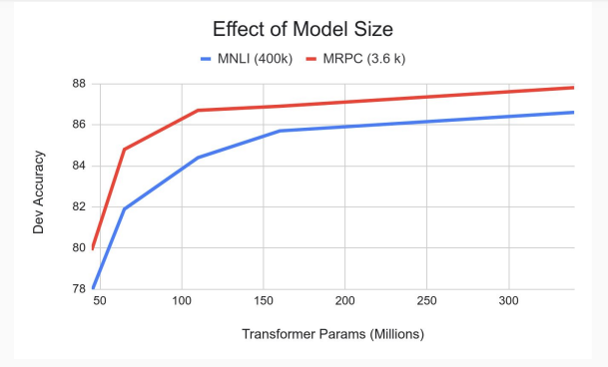
Effect of Model Size
Big models help a lot
Going from 110M -> 340M params helps even on datasets with 3,600 labeled examples

Slide 24
Post-BERT
Better models like RoBERTa, XLNet, ALBERTa and T5.
  Better pretraining objectives and / or more data and / or more parameters
Multilingual models like MBERT, XLM-RoBERTa, MBart and MT5.
  Pretraining on multilingual data
Domain-specific models like BioBERT, LegalBERT.
  Adapting general-purpose models to specific domains.
Knowledge distillation
  Distilling the knowledge in big models into smaller ones.
Zero and few shot learning
  Given no or few examples, large models can still perform quite well.

